Slide 1
Clustering Analysis

Slide 2
The K-Means Clustering Method
Given k, the k-means algorithm is implemented in four steps:
  Partition objects into k nonempty subsets
  Compute seed points as the centroids of the clusters of the current partitioning (the centroid is the center, i.e., mean point, of the cluster)
  Assign each object to the cluster with the nearest seed point
  Go back to Step 2, stop when the assignment does not change

Slide 3
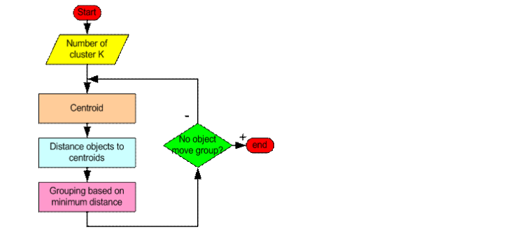

Slide 4





An Example of K-Means Clustering
K=2
Arbitrarily partition objects into k groups
Update the cluster centroids
The initial data set
Loop if needed
Reassign objects
Partition objects into k nonempty subsets
Repeat
  Compute centroid (i.e., mean point) for each partition
  Assign each object to the cluster of its nearest centroid
Until no change
Update the cluster centroids

Slide 5
Comments on the K-Means Method
Strength: Efficient: O(tkn), where n is # objects, k is # clusters, and t is # iterations. Normally, k, t << n.
    Comparing: PAM: O(k(n-k)² ), CLARA: O(ks² + k(n-k))
Comment: Often terminates at a local optimal.
Weakness
  Applicable only to objects in a continuous n-dimensional space
    Using the k-modes method for categorical data
    In comparison, k-medoids can be applied to a wide range of data
  Need to specify k, the number of clusters, in advance (there are ways to automatically determine the best k (see Hastie et al., 2009)
  Sensitive to noisy data and outliers
  Not suitable to discover clusters with non-convex shapes

Slide 6
Hierarchical Clustering
Use distance matrix as clustering criteria. This method does not require the number of clusters k as an input, but needs a termination condition
Step 0
Step 1
Step 2
Step 3
Step 4
agglomerative
(AGNES)
a
a b
b
a b c d e
c
c d e
d
d e
e
divisive
(DIANA)
Step 4
Step 3
Step 2
Step 1
Step 0

Slide 7

DIANA (Divisive Analysis)
Introduced in Kaufmann and Rousseeuw (1990)
Implemented in statistical analysis packages, e.g., Splus
Inverse order of AGNES
Eventually each node forms a cluster on its own

Slide 8
Distance between Clusters
X
X
Single link: smallest distance between an element in one cluster and an element in the other, i.e., dist(K_{i}, K_{j}) = min(t_{ip}, t_{jq})
Complete link: largest distance between an element in one cluster and an element in the other, i.e., dist(K_{i}, K_{j}) = max(t_{ip}, t_{jq})
Average: avg distance between an element in one cluster and an element in the other, i.e., dist(K_{i}, K_{j}) = avg(t_{ip}, t_{jq})
Centroid: distance between the centroids of two clusters, i.e., dist(K_{i}, K_{j}) = dist(C_{i}, C_{j})
Medoid: distance between the medoids of two clusters, i.e., dist(K_{i}, K_{j}) = dist(M_{i}, M_{j})
  Medoid: a chosen, centrally located object in the cluster

Slide 9
Density-Based Clustering Methods
Clustering based on density (local cluster criterion), such as density-connected points
Major features:
  Discover clusters of arbitrary shape
  Handle noise
  One scan
  Need density parameters as termination condition
:
  DBSCAN: Ester, et al. (KDD’96)

Slide 10
Density-Based Clustering: Basic Concepts
Two parameters:
  Eps: Maximum radius of the neighbourhood
  MinPts: Minimum number of points in an Eps-neighbourhood of that point
N_{Eps}(p): {q belongs to D | dist(p,q) ≤ Eps}
Directly density-reachable: A point p is directly density-reachable from a point q w.r.t. Eps, MinPts if
  p belongs to N_{Eps}(q)
  core point condition:
  |N_{Eps} (q)| ≥ MinPts
p
MinPts = 5
Eps = 1 cm
q

Slide 11
Density-Reachable and Density-Connected
Density-reachable:
  A point p is density-reachable from a point q w.r.t. Eps, MinPts if there is a chain of points p₁, …, p_{n}, p₁ = q, p_{n} = p such that p_{i+1} is directly density-reachable from p_{i}
Density-connected
  A point p is density-connected to a point q w.r.t. Eps, MinPts if there is a point o such that both, p and q are density-reachable from o w.r.t. Eps and MinPts
p
p₁
q
p
q
o

Slide 12
DBSCAN: Density-Based Spatial Clustering of Applications with Noise
Relies on a density-based notion of cluster: A cluster is defined as a maximal set of density-connected points
Discovers clusters of arbitrary shape in spatial databases with noise
Outlier
Border
Eps = 1cm
MinPts = 5
Core

Slide 13
DBSCAN: The Algorithm
Arbitrary select a point p
Retrieve all points density-reachable from p w.r.t. Eps and MinPts
If p is a core point, a cluster is formed
If p is a border point, no points are density-reachable from p and DBSCAN visits the next point of the database
Continue the process until all of the points have been processed

